Slide 1
Learning Objectives for Diffraction
After our diffraction class you should be able to:
Explain why diffraction occurs
Utilize Bragg’s law to determine angles of diffraction
Briefly discuss some different diffraction techniques and what can be learned from diffraction
Determine the lattice parameter from a diffraction pattern
(Future) Determine the crystal lattice type
Test: Sept 16, bring calculator and handwritten sheet
BP
Notes:
Particularly useful to put this lecture in context with what we’ve learned so far to give the big picture (BP)
May not need calculator on the first test
Perhaps I should reverse Laue/Powder order and go over some data in more detail? Could drop Laue if run out of time.

Slide 2
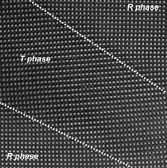
Applications of XRD
(X-ray diffraction)
XRD is a nondestructive and cheap technique. Some of the uses of x-ray diffraction are:
Determination of the structure and periodicity of crystalline materials
Determination of the orientation of single crystals
Differentiation between crystalline and amorphous materials, or if secondary phases
Measurement of (epitaxial) strain
Determination of electron distribution within the atoms, and throughout the unit cell (harder)
Measurement of layer thickness (related XRR)
Notes:
Before we get into what diffraction is, let’s discuss why you should care.
Secondary phases, compare to CaTiO3. Discuss valence. Can also form TiO2 and CaO. Also sometimes get different structures for the same atoms.
Thickness, either fringes if really thin and smooth or can do at low angle (x-ray reflectivity)

Slide 3
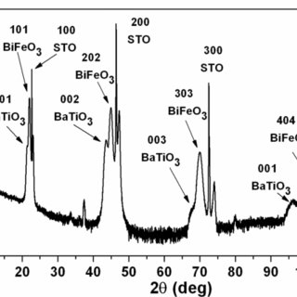
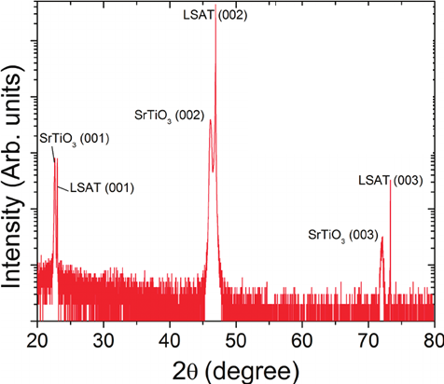
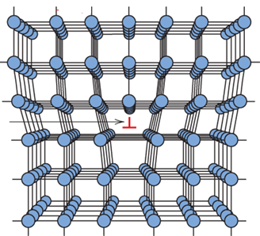
Example: How Much Can We Guess?
Anode | Cr | Fe | Co | Cu | Mo | Ag
Kα (Å) | 2.29 | 1.94 | 1.79 | 1.54 | 0.71 | 0.56
You’ve just joined a research group and been asked to determine the lattice parameters of a film your groupmate (or you) just made. Is this a good film? What does that mean?
Diffraction pattern for a film on a substrate. Both the STO substrate and LSAT film are perovskites. You would calculate the lattice parameters of both (a _{STO} and a _{LSAT}) using all three peaks (why?). Find the strain mismatch of the film and compare it to what you would expect if it matched the STO lattice parameter exactly. The bulk lattice parameter for LSAT is about 0.387 nm.
For more about LSAT, see https://en.wikipedia.org/wiki/LSAT_(oxide)
Notes:
I mention this early so you know what kinds of things to be paying extra attention to as we go through this diffraction discussion.
Is it a good film? That depends on your definition of good. But, no evidence of secondary phases (which would show up as extra peaks, note log scale). That’s a good start. It’s not fully strained, so if that is you definition of good, then no. However, thick films will never be fully strained, so it may also depend on what thickness it is.
Good example to walk them through and remind them how to use Bragg’s law (come back to later after we’ve discussed). Also a commonly done and important experimental thing and has some good misconceptions in it I can make sure they don’t mess up.

Slide 4

While there are many forms of diffraction, we start with
x-ray diffraction.
X-ray Diffraction is an optical technique.
There are many optical techniques.
Most optical techniques operate in the
Continuum limit:
Where the wavelength is bigger than the spacing between atoms. Otherwise diffraction effects dominate.
What is this spacing approximately?
Notes:
Let’s simplify our complicated crystal to just a linear chain of atoms. Our example of a chain of oscillators is nice because it is easy to visualize such a system, namely, a chain of masses connected by springs. But the ideas of our example are far more
useful than might appear from this one simple mechanical model. Indeed, many materials
(including solids, liquids and gases) have some aspects of their physical response to (usually
small) perturbations behaving just as if they were a bunch of coupled oscillators — at least
to a first approximation. In a sense we will explore later, even the electromagnetic field
behaves this way! This “harmonic oscillator” response to perturbations leads — in a
continuum model — to the appearance of wave phenomena in the traditional sense. We
caught a glimpse of this when we examined the normal modes for a chain of oscillators
with various boundary conditions. Because the harmonic approximation is often a good
first approximation to the behavior of systems near stable equilibrium, you can see why
wave phenomena are so ubiquitous. Wave phenomena are typically associated with propagation
media (earth, water, air, etc.) which are modeled as continuous rather than discrete.
The basic physical idea is reasonably simple. Often times we are interested in certain
macroscopic properties of some material (e.g., the behavior of a plucked guitar string as a
function of time and space) and we want to ignore most of the details of the microscopic
make-up of the material since they should be irrelevant for the most part. So long as the
length scales associated with the macroscopic behavior of the material (e.g., wavelengths)
are much larger than the length scales associated with the microscopic structure (e.g., the
inter-particle spacing) we can approximate the behavior of the material by taking a limit
in which the inter-particle spacing approaches zero while letting the number of oscillators
become arbitrarily large (“approach infinity”).
Why might you want to think about optical properties? There are at least two reasons. One is that you can make use of known optical materials to design and build devices to manipulate light: mirrors, lenses, filters, polarizers, and a host of others. The second is that you can measure the optical response of a new material and obtain a wealth of information about the low energy excitations in the solid.
With the use of your own eyes, you could see that solids have a wide range of optical properties. Silver is a lustrous metal, with a high reflectance over the whole visible range. Silicon is a crystalline semiconductor and the basis of modern electronics. With the surface oxide freshly etched off, silicon is also rather reflective, although not as good a mirror as silver. ∗ Salt (sodium chloride) is a transparent ionic insulator, is necessary for life, and makes up about 3.5% (by weight) of seawater. A crystal of salt is transparent over the entire visible spectrum; because the refractive index is about 1.5, the reflectance is about 4%.
If you had ultraviolet eyes, you would see these materials differently. Silver would be a
poor reflector, with at most 20% reflectance and trailing off to zero at the shortest wavelengths.
In contrast, the reflectance of silicon would be better than in the visible, reaching up
to 75%. Sodium chloride would be opaque over much of the spectrum, with a reflectance a
bit higher than in the visible. Those with infrared eyes would also see things differently from
visible or uv-sensitive individuals. Silver would have a reflectance above 99%. Silicon would
appear opaque at the shortest infrared wavelengths but would then become transparent, so
that you could see through even meter-thick crystals.† Sodium chloride remains transparent
over much of the infrared
But the continuum model does not work when the wavelength is on the order of the spacing between the atoms. Then you have diffraction.

Slide 5
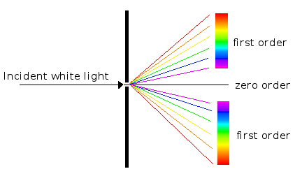
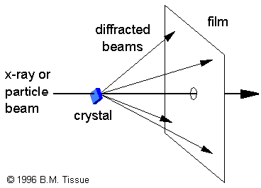
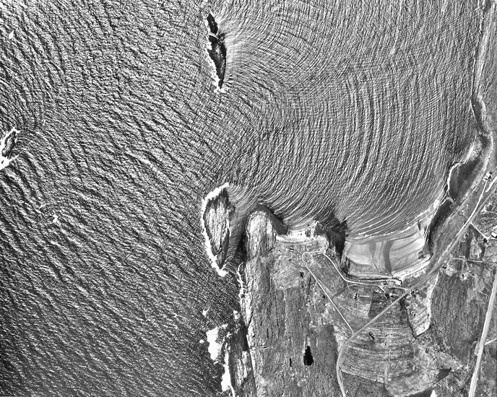
DIFFRACTION
Diffraction is a wave phenomenon in which the apparent bending and spreading of waves when they meet an obstruction is measured.
Diffraction occurs with electromagnetic waves, such as light and radio waves, and also in sound waves and water waves.
X-ray diffraction is optimally sensitive to the periodic nature of the solid’s atomic structure.
Notes:
These shown water waves have wavelengths a little smaller than the geographical formations and thus we see diffraction.

Slide 6
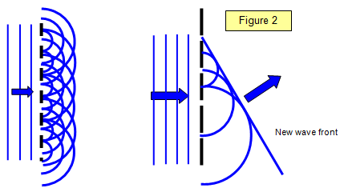
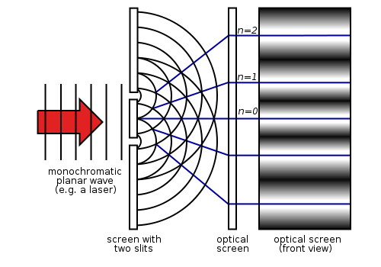
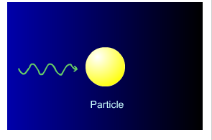
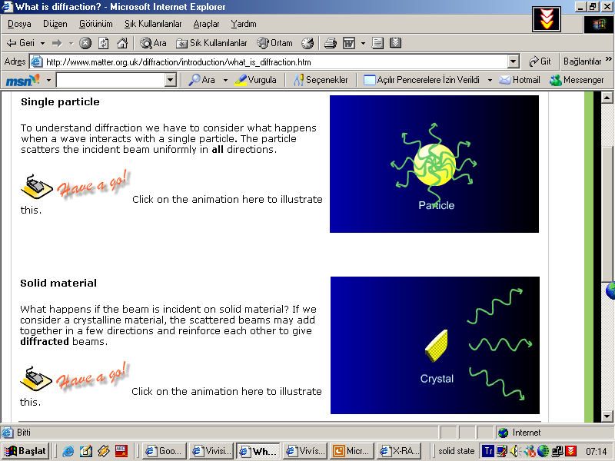
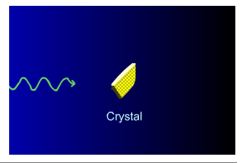
When X-rays interact with atoms, you get scattering
Scattering is the
emission of X-rays of
the same frequency/energy
as the incident X-rays in all
directions (but with
much lower intensity)
Similar to the double slit experiment, this scattering will sometimes be constructive
Notes:
Second order process due to phase ambiguity, doesn’t matter if initial photon is absorbed before emitted photon.
See from Fermi’s golden rule (Ch.4 in the book).

Slide 7
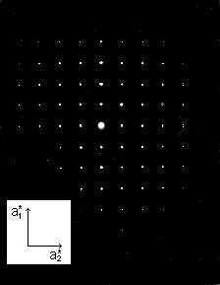
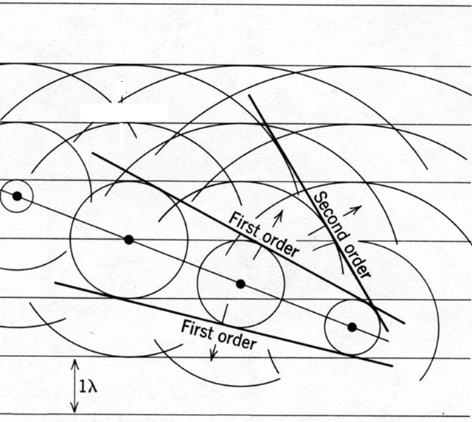
Incident beam
Will look at this again shortly
Second order
Zeroth Order
Notes:
Note diameter of smallest circle is one wavelength. Third circular is two wavelengths. The light must be incident over some time to create the wavefronts shown.
Careful study of the pattern of theses beams can tell you a lot about the structure (see applications of XRD slide).
An xray peak set is just a slice through this pattern.

Slide 8
Physical Model for X-ray Scattering
Consider a plane wave scattering on an atom.
Atom
The book lists k_{o} as just k, but I find that confusing, so I typically add the subscript
Notes:
Reason for adding subscript: in most texts just k would stand for the final k value and here it’s opposite so I like to add the o. That way it’s absolutely clear which I mean.
For now you can just realize from Modern physics and quantum mechanics that the wavevector k is related to the energy by E=hbar^2 k^2 /(2m) for a particles or in the case of a photon E=hbar*velocity*k (You can figure this out from starting with E=hbar omega and using v=frequency times wavelength and so on)
Why isn’t r squared? We are looking at psi, not intensity.
This is a different approach from the book, but I think its helpful for visualizing the geometry involved. It will also help to understand what the structure factor is (in next class).

Slide 9
Defining the distances (confusing) for a sample
Sample (made up of lots of atoms)
Atom
k_{o}
R
R’
source
Detector
And of course these atoms are not all at the same R. How do we account for that?

Slide 10
Diffraction In a Crystal of Many Atoms
Each incoming amplitude can be written:
To calculate amplitude of scattered waves at detector position, sum over contributions of all scattering centers P_{i} with scattering amplitude (form factor) f:
P_{i}
r_{i}
k_{o}
R
R’
R’-r_{i}
source
Lots doesn’t depend on the sum over positions
Detector
The intensity that is measured (can’t measure amplitude) is
Scattering vector
Kittel calls G, but K is another common notation.
Notes:
Drop the time dependence for now to make it simpler; it’s just a phase that will disappear if you multiple by complex conjagate.
Trace out triangle for R’-ri on powerpoint and/or put on board.
Could plug into top equation on the board to show that you get the value after the arrow.
Generic for any point in the sample. (ignoring the time dependence, will disappear when we multiply by the complex conjugate)

Slide 11
Diffraction Theory
k’
G=k’-k_{o}
P_{i}
r_{i}
k_{o}
k_{o}
R
R’
R’-r_{i}
source
Detector
The intensity that is measured (can’t measure amplitude) is
Scattering vector
Kittel calls G, but K is another common notation.
Notes:
Generic for any point in the sample. (ignoring the time dependence, will disappear when we square it)

Slide 12
The Bottom Line
If you do the math you can prove that the peaks only occur when (a₁, a₂, a₃ = lattice vectors):
n₁, n₂, n₃ integers
Compare these relations to the properties of reciprocal lattice vectors:
Notes:
This requires a bunch of math to show that could take a good portion of the class today if I wanted to. However, that’s not really the point of this class. Better just to trust me here and learn how to us it.

Slide 13
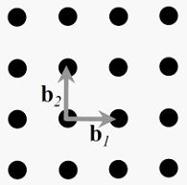
The Laue Condition
Replacing n₁ n₂ n₃ with the familiar h k l, these three conditions can be equivalently expressed as:
G
(Max von Laue, 1911)
So, the condition for nonzero intensity is that the scattering vector G is a translation vector of the reciprocal lattice.

Slide 14
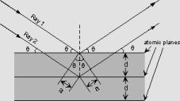
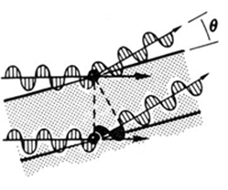
From Laue to Bragg
The magnitude of the scattering vector G depends on the angle between the incident wave vector and the scattered wave vector:
Show vector subtraction on the board
=λ/2
Notice this angle is 2θ!
Elastic scattering requires:
So from the wave vector triangle and the Laue condition we see:
Leaving Bragg’s law:
If the Bragg condition is not met, the incoming wave just moves through the lattice and emerges on the other side of the crystal (neglecting absorption)
Notes:
A very common kind of measurement is the theta-2theta scan. Discuss. Easy to get confused about the angle.
Draw vector k-ko on the board to illustrate correct direction of K.
Elastic scattering requires no energy lose, so k’s magnitude is the same
Use right triangles to show 2ksin theta
You can use a similar argument to show how d and lambda are related from the diagram on the left. a=dsin theta (D=lambda/2 sin theta) Define sin of theta to show this.

Slide 15
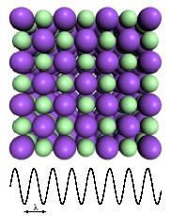
How does this limit λ?
where, d is the spacing of the planes and n is the order of diffraction.
Bragg reflection can only occur for wavelength
This is why we cannot use visible light. No diffraction occurs when the above condition is not satisfied.
Notes:
What jumps out at you as a necessary condition for this to be true?

